Slide 1
Project NLP
Business Case: Automated Customer Reviews
“Your next favorite product... already sorted, summarized, and served.”
Baggiyam Shanmugam
Mercy
Sneha
Jean-Denis
Drane

Slide 2



Imagine if you could read thousands of Amazon reviews in seconds. Now you can.
“The pitch”
We built a smart NLP system that reads, understands, and summarizes product reviews — helping users find the best picks while letting businesses know what customers really think.
From AI-driven sentiment detection to product clustering and GPT-powered summaries — this is product intelligence at its finest.k.
r

Slide 3
What we built
Solution Architecture
Our pipeline automates the process in three stages:
Sentiment Analysis (DistilBERT)
Clustering (KMeans, BERTopic)
Summarization (GPT-4o)
Each model feeds the next — with outputs becoming structured insights.
Real-World Problem
E-commerce platforms are overwhelmed by user-generated content. Manually extracting insights from reviews is slow, biased, and expensive.

Slide 4
Global Pipeline Overview
Dataset: Combined two Amazon review datasets (~30K reviews)
Preprocessing: Clean text, deduplication, sentiment tagging
Pipeline:
Methods
Raw Data → Preprocessing → Sentiment Classifier → Product Clustering (KMeans & BERTopic)→ GPT Summary

Slide 5
Model 1 - Sentiment Classification
Goal: Understand customer tone: Positive, Neutral, or Negative
Approach:
Fine-tuned DistilBERT on labeled Amazon reviews
Tokenized and classified each review
Used for downstream clustering and analysis
Why DistilBERT? Fast, lightweight, high accuracy on short texts
r

Slide 6
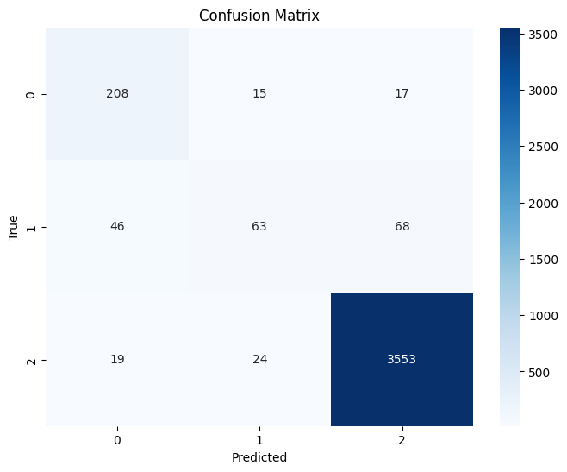
Model 1 - Sentiment Classification
Achieved :
Accuracy: 95.29%
Most reviews are positive, but model generalizes well
Evaluation:
Confusion matrix
Manual review of mismatches
Balanced class performance despite skew

Slide 7
Model 2a - Product Clustering (ST + UMAP + KMeans)
Goal: Identify high-level product groups
Steps:
Sentence Transformers to create semantic embeddings of sentences
Dimensionality reduction using UMAP
Clustering with KMeans (11 clusters found optimal)
Human interpretation to label clusters meaningfully (e.g., Alexa, Kindle, Accessories))

Slide 8
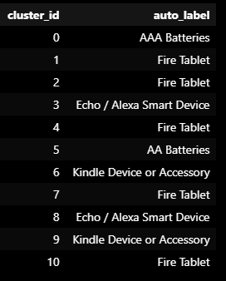
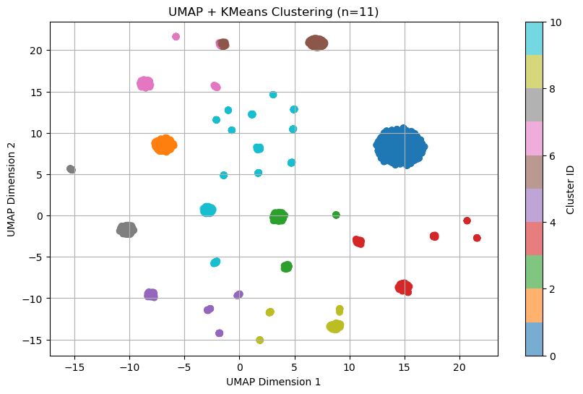
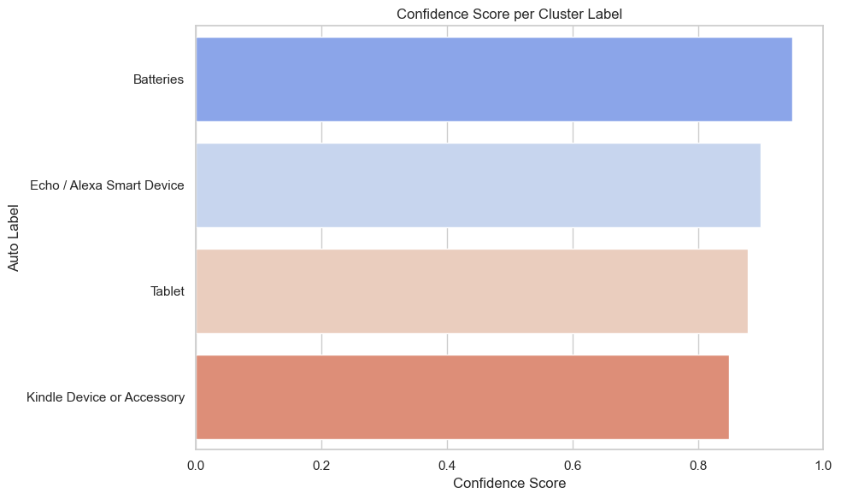
Model 2a - Product Clustering (ST + UMAP + KMeans)
Clusters discovered
Key Outcomes:
Discovered coherent product groupings
Kindle, Fire Tablets, Alexa, Accessories, etc.
Evaluation:
UMAP visual inspection
Cluster distribution charts
Heuristic-based cluster labeling with CountVectorizer
Confidence scoring & interactive visualization
ar

Slide 9
Model 2B - Product Clustering (ST + UMAP + BERTopic)
Goal: Identify high-level reviews groups
Generate dense vector representations of customer reviews
Discover and visualize meaningful topic clusters
Extract top keywords and representative reviews per topic
Assign interpretable tags to each cluster for downstream use (e.g., dashboard filters, marketing segmentation)
BERTopic, as a state-of-the-art topic modeling framework that combines:
Transformer-based embeddings (e.g., all-MiniLM-L6-v2)
Dimensionality reduction with UMAP
Density-based clustering using HDBSCAN
After clusterization:
Topic representation using class-based TF-IDF

Slide 10
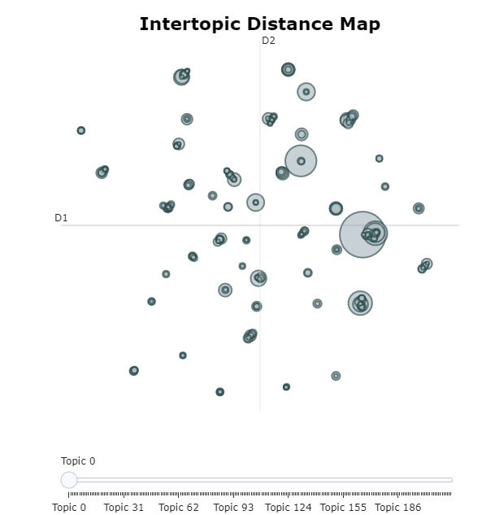
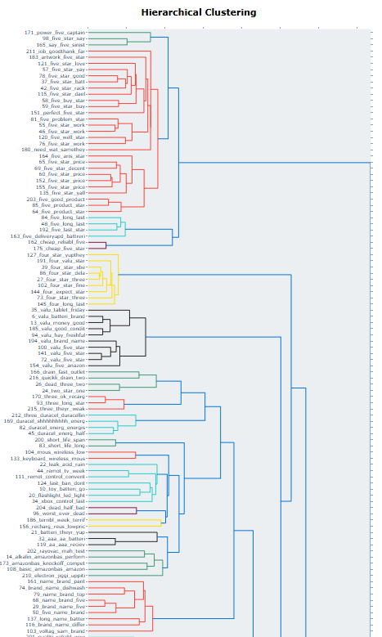
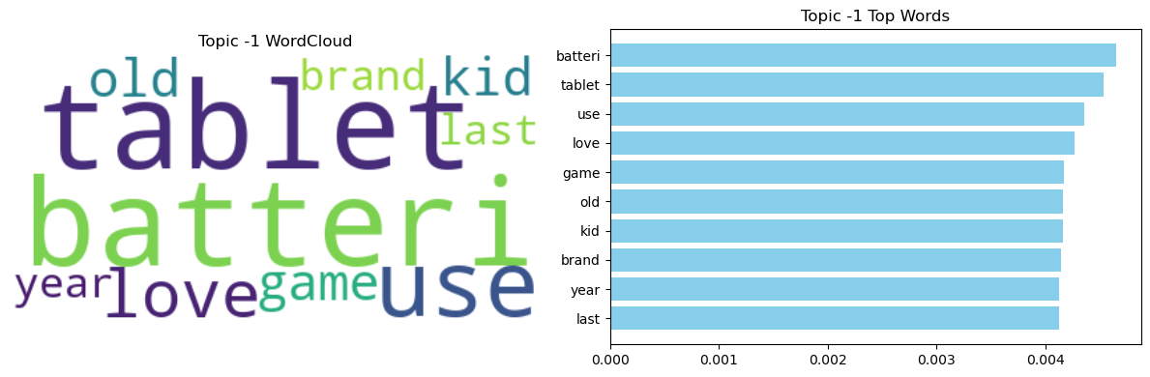
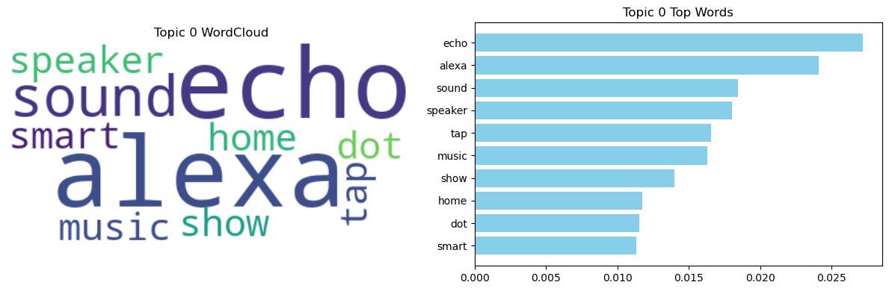
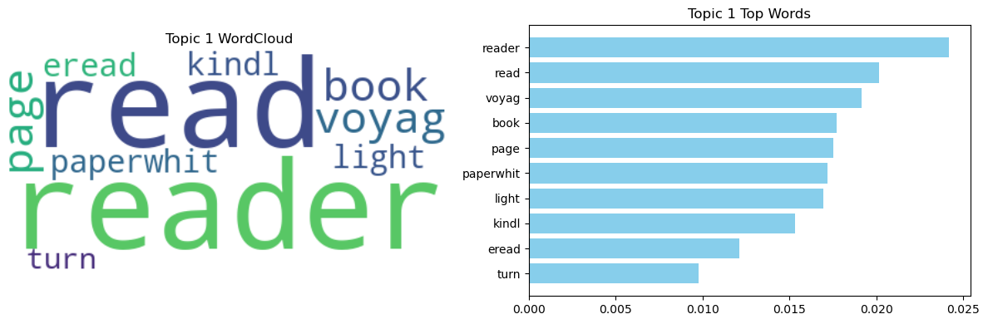
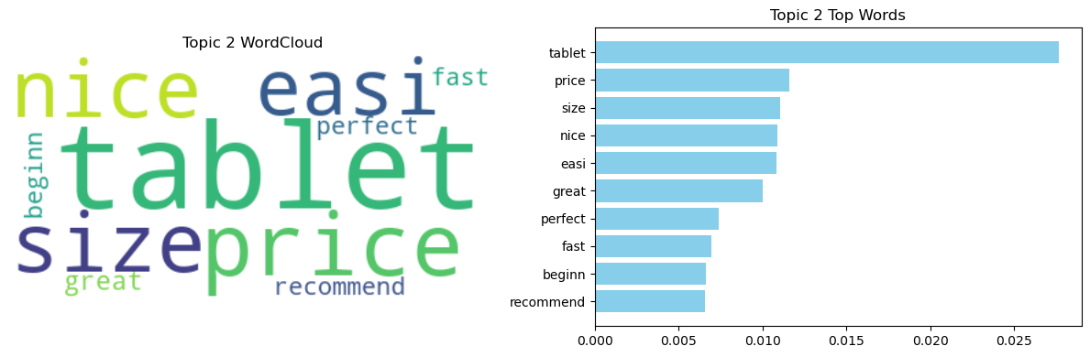
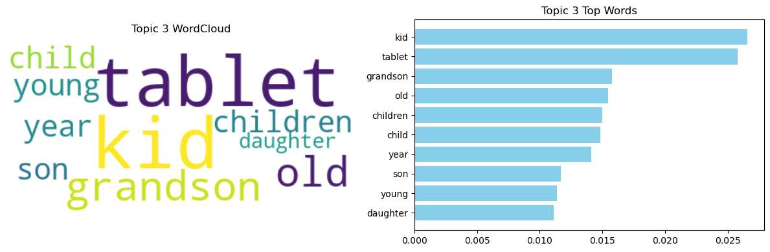
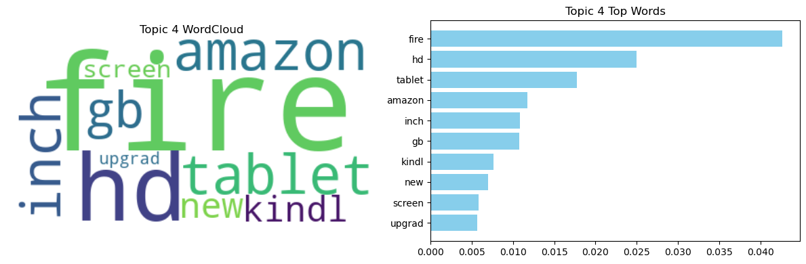
Model 2a - Product Clustering (ST + UMAP + BERTopic)
Clusters discovered:
More than 200 by measured with Intertopic Distance
Reduced to 6 with TF-IDF
Key Outcomes:
Discovered coherent product groupings from review semantic
These tags enrich product metadata and were reused in summary prompts to GPT-4o
Evaluation:
UMAP visual inspection
Intertopic Distance Map
Heuristic-based cluster labeling

Slide 11
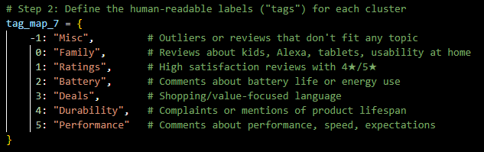
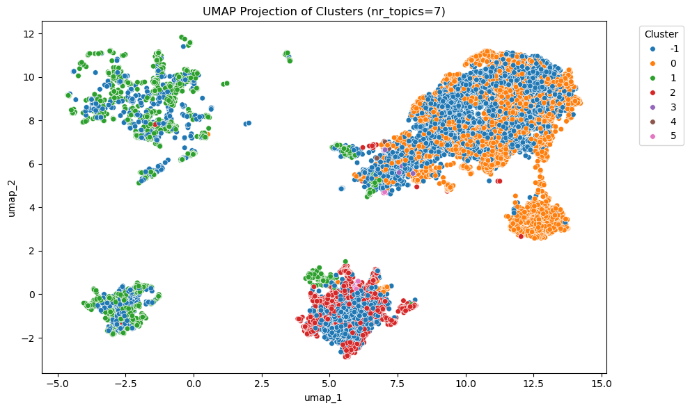
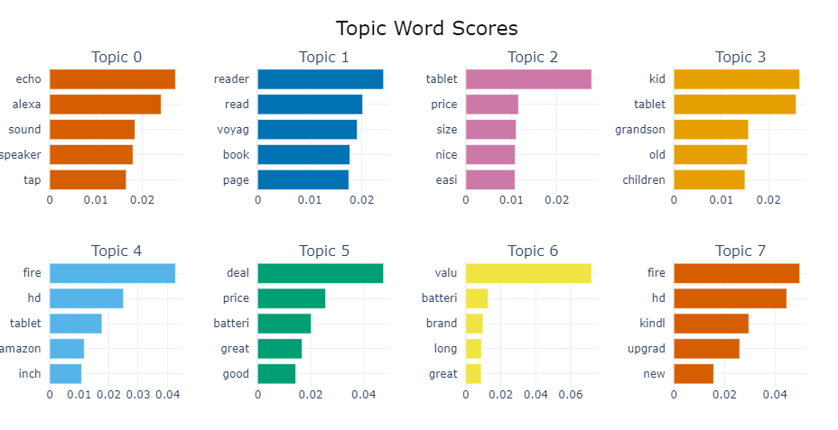
Model 2a - Product Clustering (ST + UMAP + BERTopic)
BERTopic fined tuned to reduced number of clusters
More than 200 by measured with Intertopic Distance
Reduced to 6
Heuristic-based cluster labeling

Slide 12
Model 3 - GPT 4o Generative AI Summarization
Goal: Create clear summaries of product reviews per category
Workflow:
Grouped reviews by product & cluster
Collected average rating, representative samples
Prompted GPT-4o to output structured summaries in JSON format

Slide 13
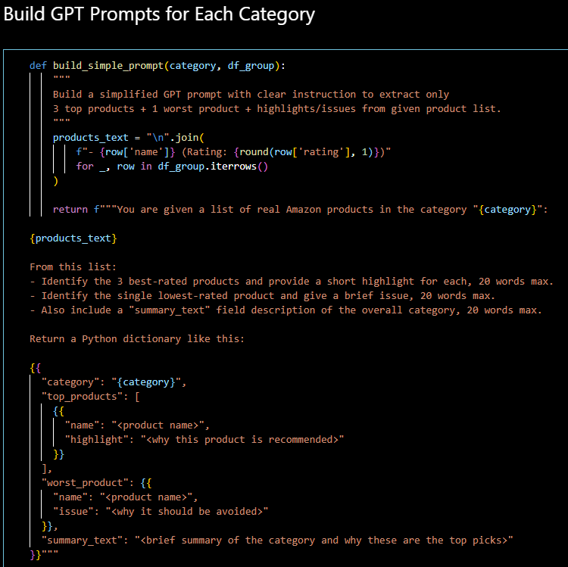
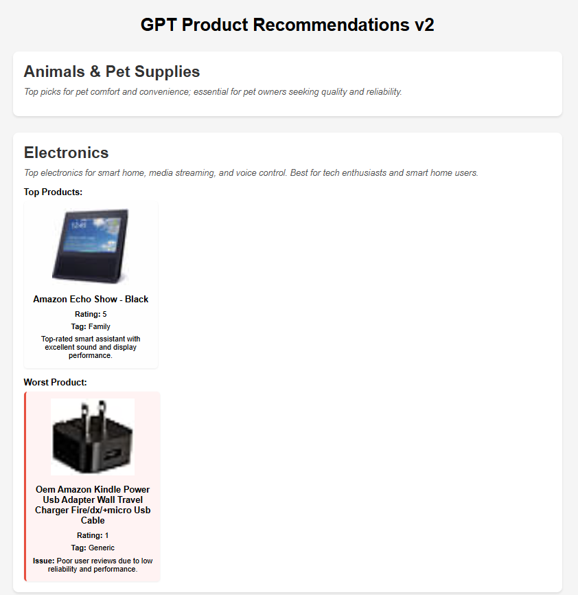
Model 3 - GPT 4o Generative AI Summarization
Results:
Generated readable summaries <20 words
JSON outputs structured as:
Summary text
Top product(s) (with tag, image, rating)
Worst product(s)
Strengths:
Captures user voice in a digestible format
Easy to plug into UI or reports

Slide 14
Final outcome
1
2
3
4
Classified with 95.29% accuracy
Products clustered into 11 semantic categories
GPT-generated summaries + product recommendations
Cleaned and labeled review dataset
🏅Sub-clusterization to 6 ‘tag’

Slide 15
Demo
Thank you
Let’s talk

